Slide 1


DIY
PROJECT
RC CEILING ROVER
Where you find it difficult to go, it runs
GROUP ID - 11
SECTION - 14

Slide 2
There are some places where the human head can’t go or risky. Just think of your ceiling with many electrical connections.
Problem Statement:

Slide 3

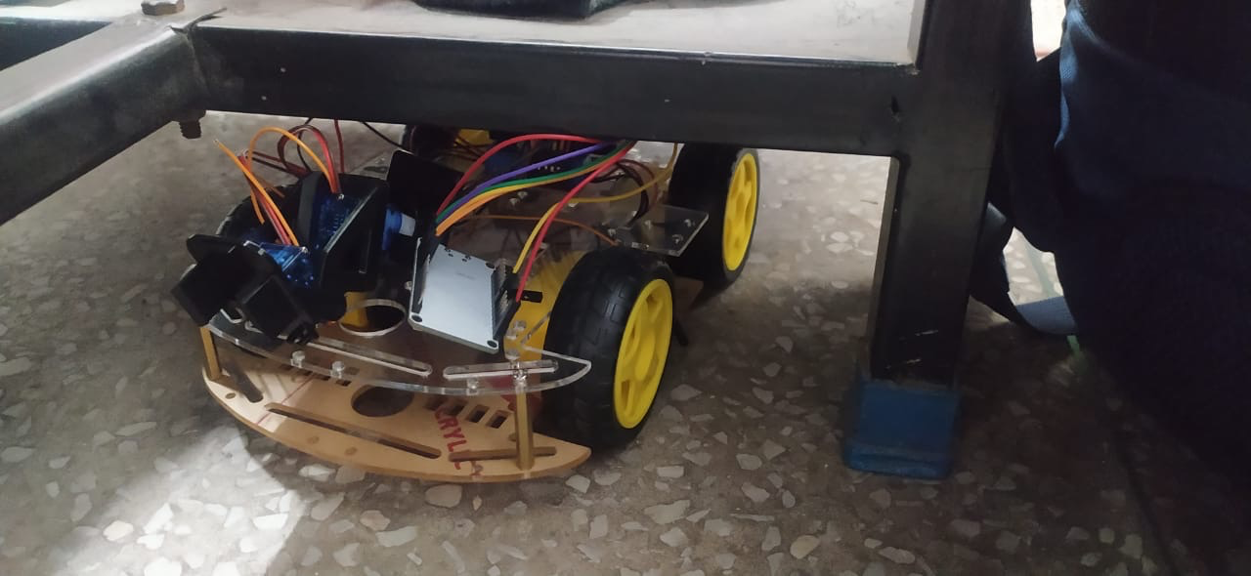
MOTIVE
To explore inaccessible or hard-to-reach areas such as ceilings or high shelves.
Remote surveillance and exploration of these areas without risking human safety or requiring physical access.
Easy to operate and control

Slide 4
Solutions:
Hence we use components such as ESP32, Motor driver and others to keep an eye on such places.
We used WiFi to transfer data received by ESP32 by camera to Mobile Phone.
An RC Rover that could provide an imagery of small and compact places.
For example, manholes, sewers, ceilings, etc..
Considering such places just to check out small faults, we do not open entire system.

Slide 5
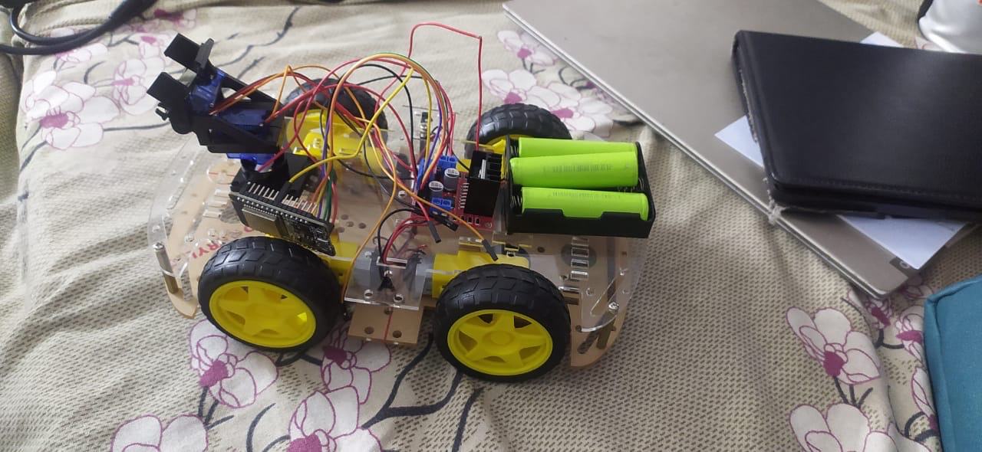
INTRODUCTION
RC rover is 4 wheeled car whose movement powered is by gear motors.
The rover is connected to Wifi by ESP32 Wifi module and controlled by Wifi connected Web Page.
The Pan Tilt Assembly is made for movement of camera.
The car is powered by Lithium Ion battery.

Slide 6
Methodology
The esp starts and requests connection to the given WiFi network.
After connection it created a Webpage using the same Wifi Network.
User access the network to send command by the HTML webpage
These are received by the ESP and performs the allotted functions as specified.

Slide 7
COMPONENTS
L298N 2A Dual H Bridge Motor Driver Module
2 Axis Servo Pan Tilt Assembly for SG90 MG90
Mini Servo Motor SG90 180 Rotation
ESP32 WROOM
4-wheel Robot Car Chassis Kit
AMS1117 5V Step Down Power Supply Module
Jumper Wire and Connecting wire
Li ion Battery and Battery Holder
Also tried, ESP32 Cam Module, OV7670 Cam, Arduino UNO,9V HW Battery

Slide 8
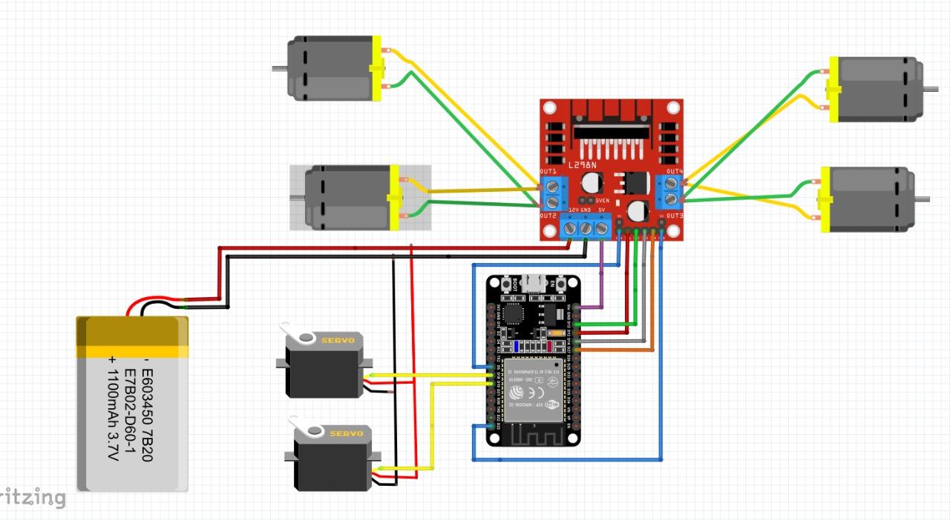
CIRCUIT DIAGRAM

Slide 9

Defining variables and Assigning Pins
Connecting to web server and communication
Web page code
Motor Controls
Servo Controls
CODE

Slide 10
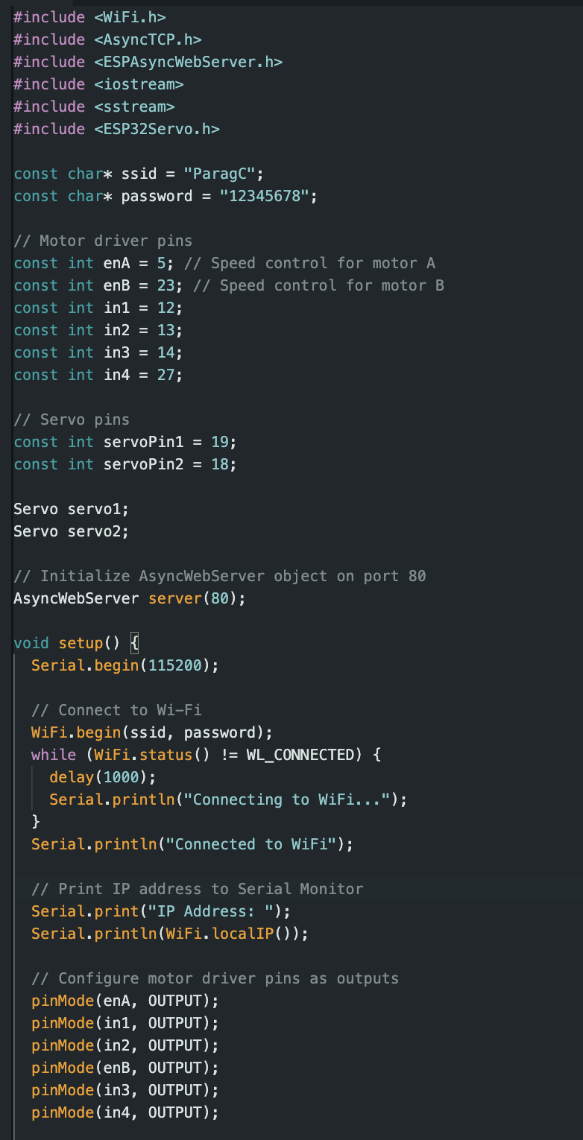
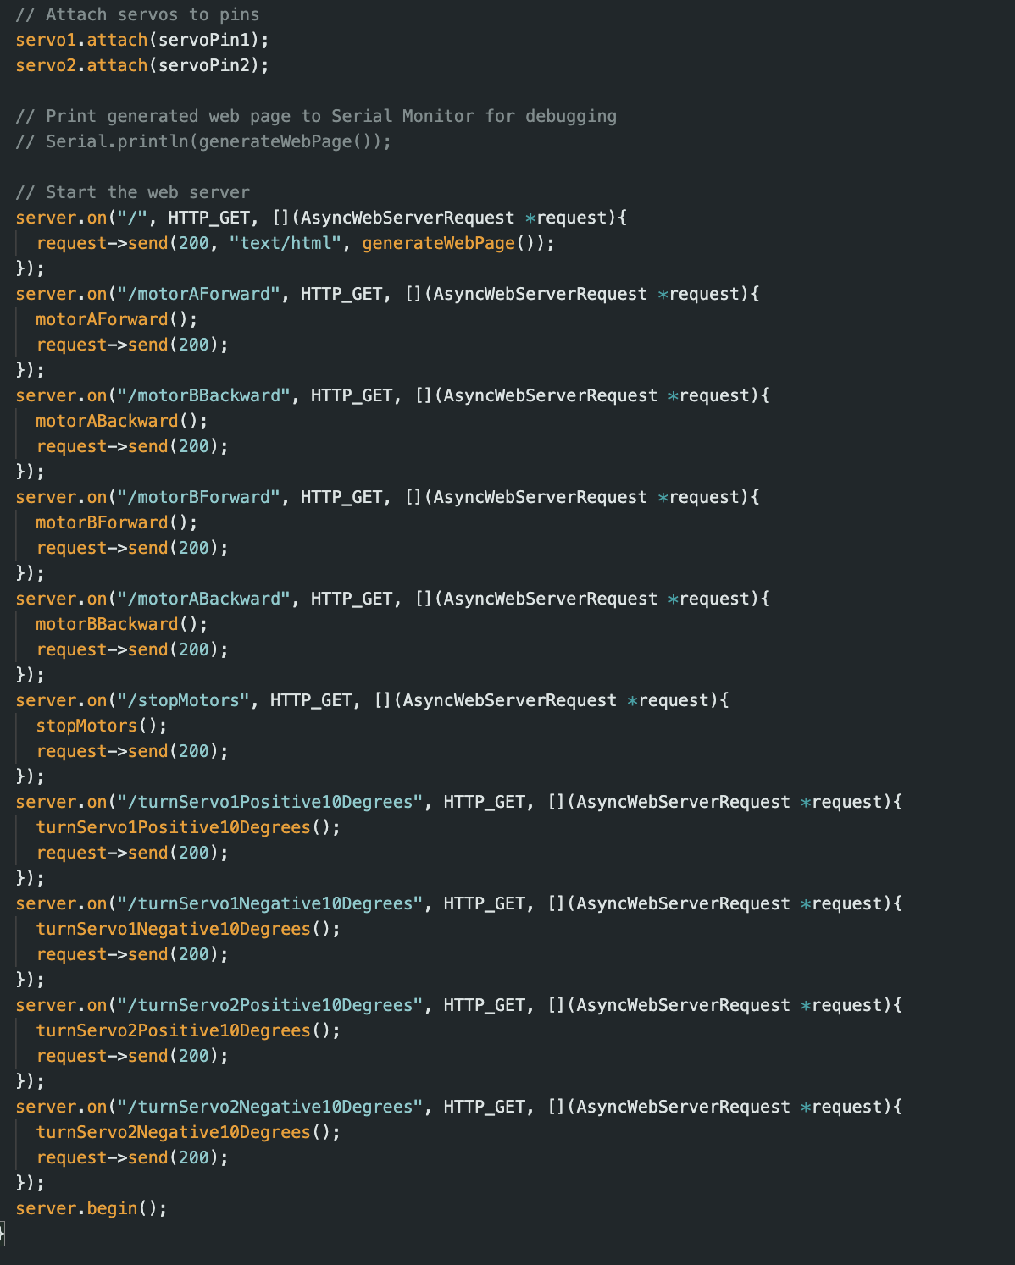

Slide 11
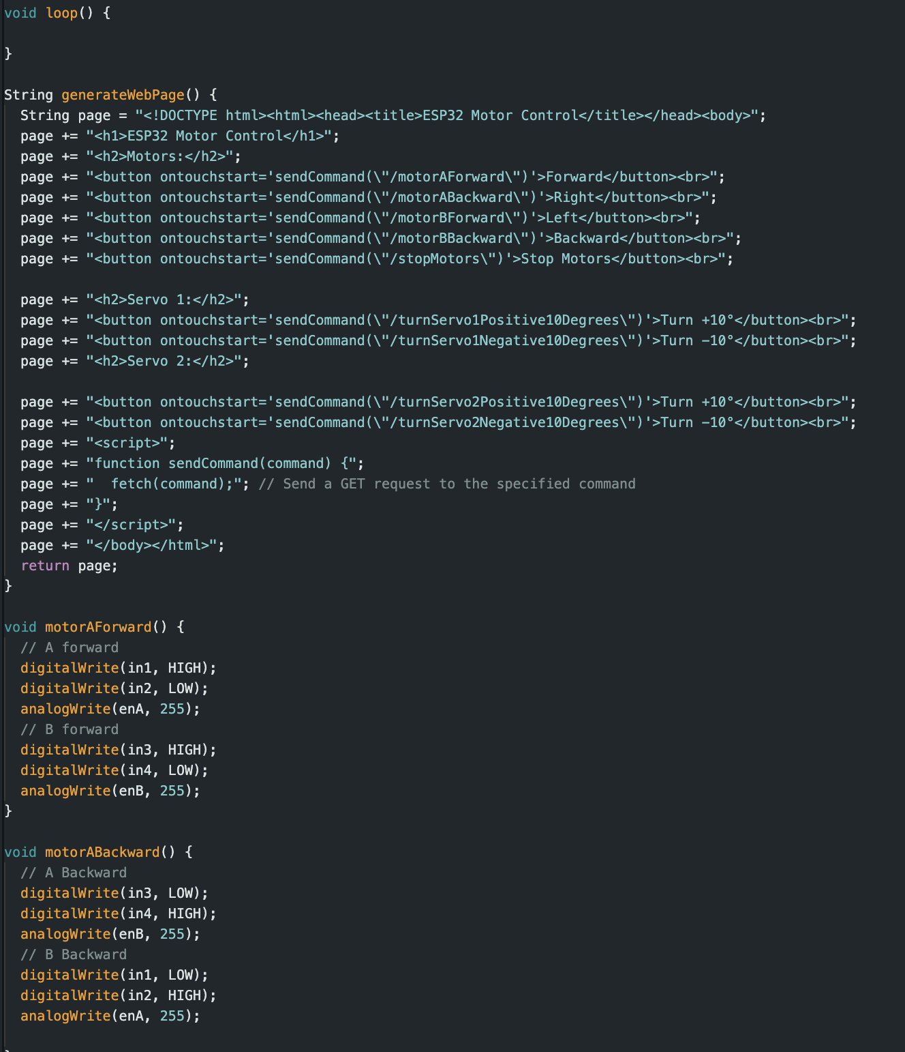
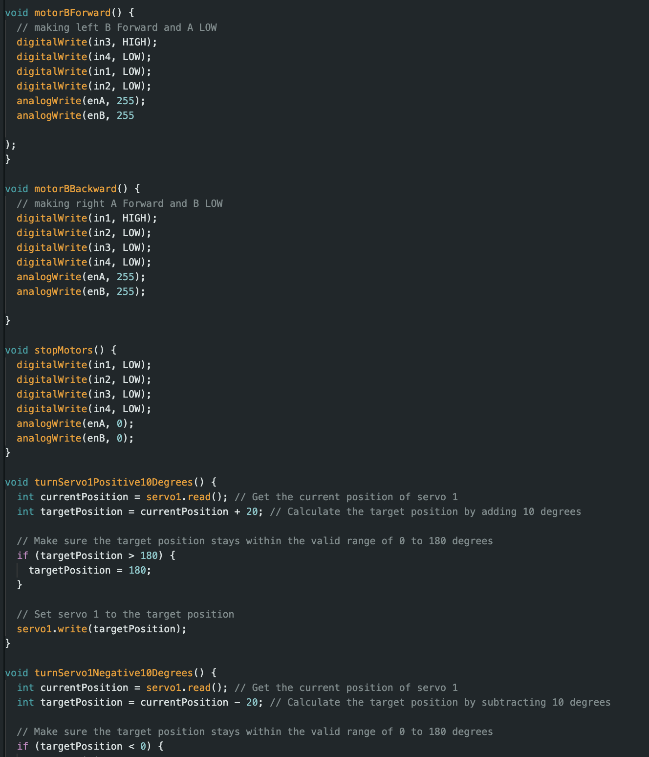

Slide 12
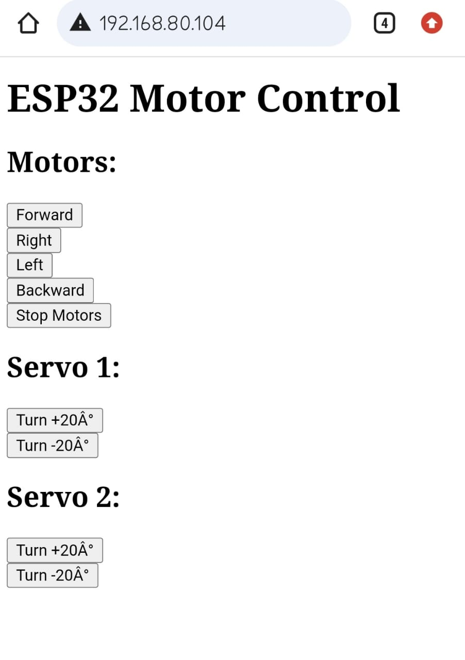
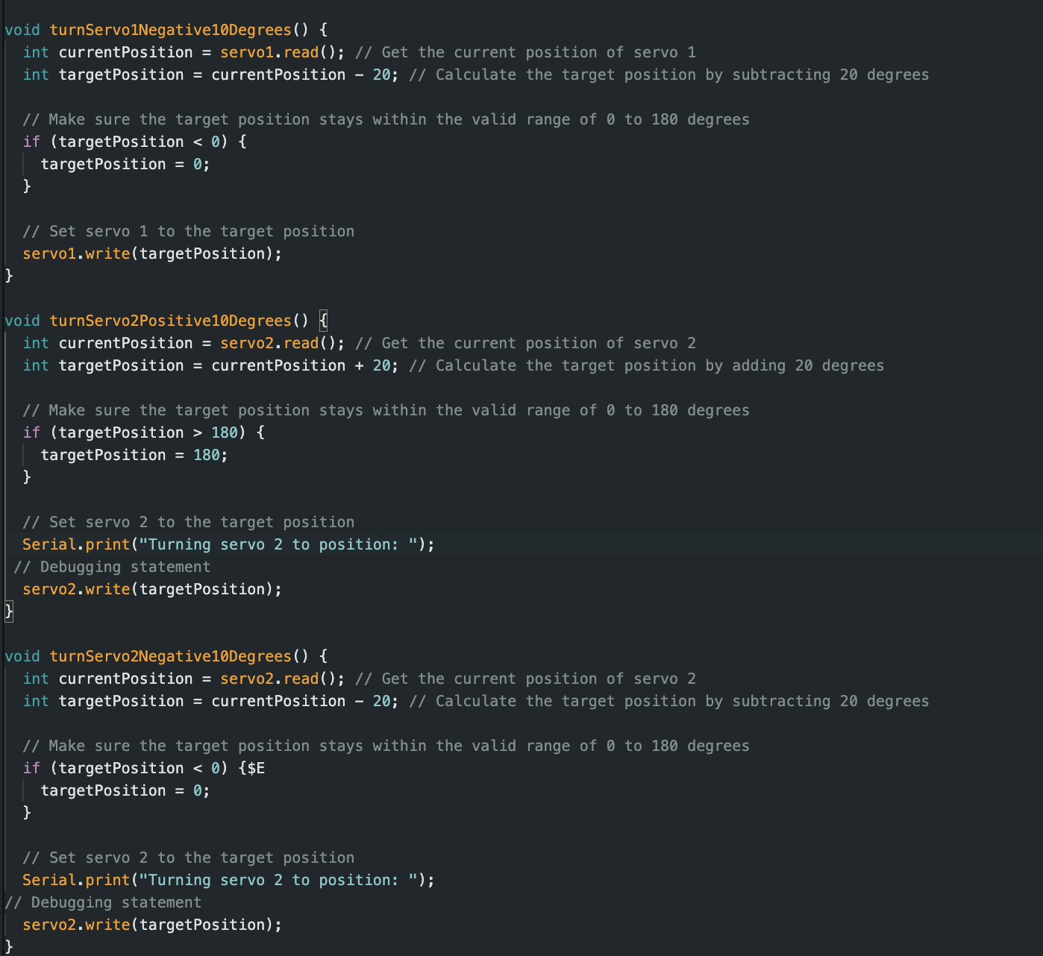

Slide 13

CHALLENGES
We planned to work with ESP32 CAM module, but it didn’t the module malfunctioned.
Working with Arduino supported OV7670 CAM is not feasible for the project.
We have to start the code with scratch and understanding the connections of components and pins due unavailability of reference code.
Lack of knowledge on Web development.

Slide 14
Our project aims to achieve the following objectives:
Develop a robust RC car platform capable of traversing ceilings and other surfaces.
Integrate a high-quality camera module for real-time video streaming.
Implement wireless communication using ESP32 for remote control and data transmission.
Ensure user-friendly operation through intuitive control interfaces.
Explore potential applications in surveillance, inspection, and education.

Slide 15
Learnings:
Understanding Pins of ESP32 and L298N Motor driver.
Programming ESP32
Learning Wifi connectivity with Web Server.
Working of Servo Motors and Gear Motors.
Data(Video) transfer via Wifi through CAM Modules.
Future Direction:
Making the RC car more compact and sturdy.
Controlling the gear motor speed.
Pan Tilt to be controlled by scrollbar.
Increased range of wifi connectivity.
Camera to be intact with the car and connected to Wifi module

Slide 16
BENEFITS AND ADVANTAGE
Remote Exploration: The RC ceiling rover enables remote exploration of inaccessible or hard-to-reach areas such as ceilings, high shelves, or confined spaces. This capability is particularly useful in environments where human access is limited or unsafe, allowing for thorough inspection and exploration without risking personal safety.
Cost-Effective Solution: Compared to traditional methods of inspection and surveillance, which may involve specialized equipment or personnel, our RC ceiling rover offers a cost-effective alternative. By utilizing off-the-shelf components and open-source platforms like Arduino and ESP32, we've developed a solution that is affordable and accessible to a wide range of users.

Slide 17
3.Real-Time Surveillance: With its integrated camera module and wireless communication capabilities, the RC ceiling rover provides real-time video streaming for surveillance purposes. This enables users to monitor indoor spaces remotely and respond promptly to any security threats or anomalies.
4.Versatility and Maneuverability: The ability of our rover to traverse ceilings, walls, and other surfaces adds a level of versatility and maneuverability that is not typically found in conventional RC vehicles. This allows for comprehensive exploration and inspection of diverse environments, making it suitable for a variety of applications.
5.Wireless Control and Accessibility: The use of wireless communication technology, facilitated by the ESP32 microcontroller, enables remote control of the rover from a smartphone, tablet, or computer. This enhances accessibility and convenience, allowing users to operate the rover from a distance without the need for direct line-of-sight

Slide 18
Team Members
Parag Chimankar
Bhukya Shashi Kumar
Ujjwal Sharma
Ayush Gupta
23CS10049
23EE10014
Code for ESP (web connection and website), RC rover functioning and Servo Motors
Assembly of Rover and Pan Tilt with Servo Motors Website video uploading through websocket
Assembly and Camera connectivity ( ESP32 CAM and OV7670)
23AG10045
23MI10012

Slide 19
Resources
Youtube Videos by hashincludeelectronics,and others
AI tools( Chat GPT, Gemini)
W3school website for webpage related queries.
Projects by arduino website

